Slide 1
Automatic Classification of Students on Twitter Using Simple Profile Information

Slide 2
Md Sadaf Noor
20366022
1.Introduction
Existing Techniques:
surveying individuals,
analyzing geographic proximity to educational institutions
manually annotating users one by one
Twitter and match them with professional mentors on LinkedIn
Usefulness:
Professional networking
Spread of Misinformation
Successful classification:
Gender
Age
Organization
Proposed Technique:
7 numerical features
Decision Making:
Student / Non Student
accuracy: 88.1%
F1 score: .704
10 text-based features

Slide 3
1.1 Project Motivation
1.2 Ethical Consideration
S.M. Mushfiqur Rahman
16101040
Project part of investigation into students interact with misinformation
Twitter is still considered the most misinformation
Misinformations put people at risks
Find out if and how students spread false information
Try the best education system for students to stop misinformation
Students are more vulnerable to scammers and online predators
Students might get targeted with spam and harmful content

Slide 4

Jahid Hasan Mamun
21166047
2. DATA
Sample Type | S | N-S | Total
General Stream | 11 | 53 | 64
Hunter College | 127 | 743 | 870
“Who to Follow” | 86 | 8 | 94
Total | 224 | 804 | 1028
Dataset:
Students(“S”) =225
Non-Students(“N-S”) =812
Total =1037
S = 21.7%, N-S = 78.3%
Manually Labeled Based on:
Twitter Bios, Tweet Content, LinkedIn and Instagram Profiles.
Other indicators:
Job Status, Graduation Status, followers of “Hunter College”, “Who to follow” feature
Limitations
50% samples could not be identified.
Time-intensive manual labeling process.
Uneven distribution.

Slide 5
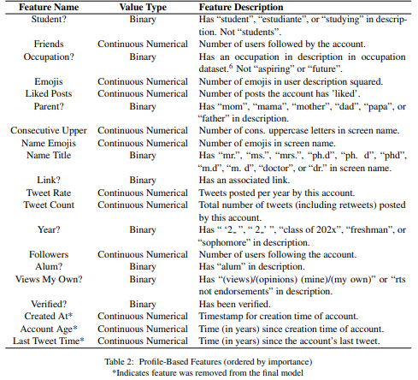
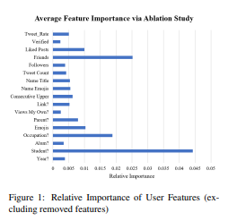
Aryan Shrestha
16201074
3.1 Feature Extraction
To Training the models a combination of metadata based features and custom text based features were used. (Table 2)
Users without descriptions, zeros were recorded for all description-based features .
Features were scaled to similar ranges using scikit-learn’s StandardScalerto improve model’s performance.
Only profile information was incorporated into this mode.
User features were extracted using the Twitter API in batches of 100 user IDs which limits requests to 900 per 15 minutes, that means 90,000 users to be extracted per 15 minutes.
3.2 Feature Selection
Twenty original features were extracted from each user, and three were removed due to low importance to the machine learning models .
Importance was assessed via logistic regression importance rankings, decision tree rankings, random forest rankings, and LASSO rankings.
This feature removal was verified via an ablation study, whichshowed that all remaining features had a positive importance averaged across all six models (Fig. 1)

Slide 6
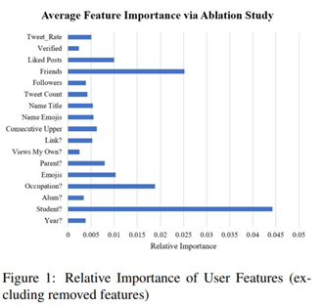
3.3 Model Selection
Md. Mofaqkhayrul Islam Mim
20266013
Six distinct machine learning models were implemented by the authors in scikit-learn (Pedregosa et al., 2011) to create student identification classifier: 1) Logistic Regression, 2) Random Forest, 3) SVM, 4) K-Nearest Neighbors, 5) AdaBoost and 6) a Stacked Classifier.
To optimize each model for the highest F1 score, they used a grid search of model hyperparameters combined with 10-fold cross-validation
Fig-1, showed that, The "Student?" element was heavily emphasized by the models. A simple "if-statement classifier" was constructed to see if the machine learning models were adding anything to the categorization. It classified a user as a student if the “Student?” feature was set to 1.

Slide 7
3.4 Model Tuning
Md. Mofaqkhayrul Islam Mim
20266013
They enhanced the results by adding regions within their prediction probabilities, which they term "gray zones," where their models would identify a user as "uncertain," after picking the best three model types based on F1 score and AUROC.
By using 10-fold cross-validation to examine 39 candidates, these regions were discovered. For each of the three model types, two gray area candidates were chosen based on accuracy and F1 score.

Slide 8
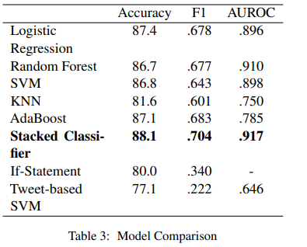
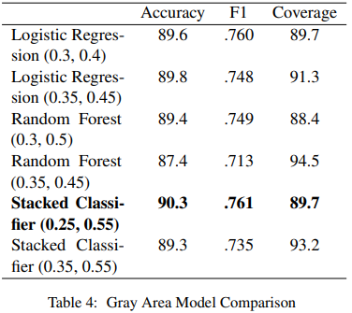
4.0 Results
Md Tarikul Islam
21166020

Slide 9
Conclusion
S M Ibrahim
21166045
In this paper, the author introduces a metadata-based machine learning model to predict student Twitter users accurately.
They also introduce a gray-area model that achieves 90.3% accuracy without leaving many users unlabeled. Their models improve upon past research by providing more accurate, more efficient, and faster classifications due to their use of only simple profile information.
Currently, they are working to apply this student classifier in a preliminary study of student interactions with COVID-19 related misinformation on Twitter.

